Slide 1



Project 4 Presentation
Ian Luckeydoo, Blake Sodikoff, Angelo O’Dorisio
Ian Luckeydoo
Angelo O’Dorisio
Blake Sodikoff

Slide 2

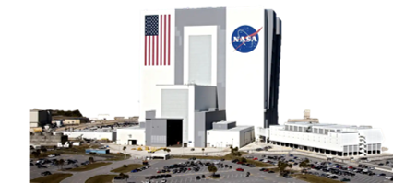
Abstract
Simulating the internal composition of exoplanets provides valuable insights in to the structure and formation of rocky planets. In this project, we utilize the ExoPlex software to model the interior structure of GJ-1132b, a known terrestrial exoplanet. By comparing its simulated composition to that of Earth, we assess differences in core, mantle, and crustal properties. Additionally, we place GJ-1132b’s structure and composition in context by analyzing its predicted mineral properties alongside its orbital parameters, offering a comprehensive perspective on its internal composition.

Slide 3
Motivation
Why are we doing this
We are eager to learn new ways to learn about exo-planets and their interiors, therefor leading to an increase in “Earth-Like” Planets, here we focus on mineral composition and orbital paramters

Slide 4
Methodology
Warm up
Results
To make sure we were knowledgeable enough about Exo-Plex some warm ups were given
We calculated Earth’s radius as roughly 0.999 Earth radii, given as its still a work in progress we took it
Notes:
To make sure we were knowledgeable enough about Exo-Plex some warm ups were given, we used the Sun’s proportions of Fe, Mg, and Si

Slide 5
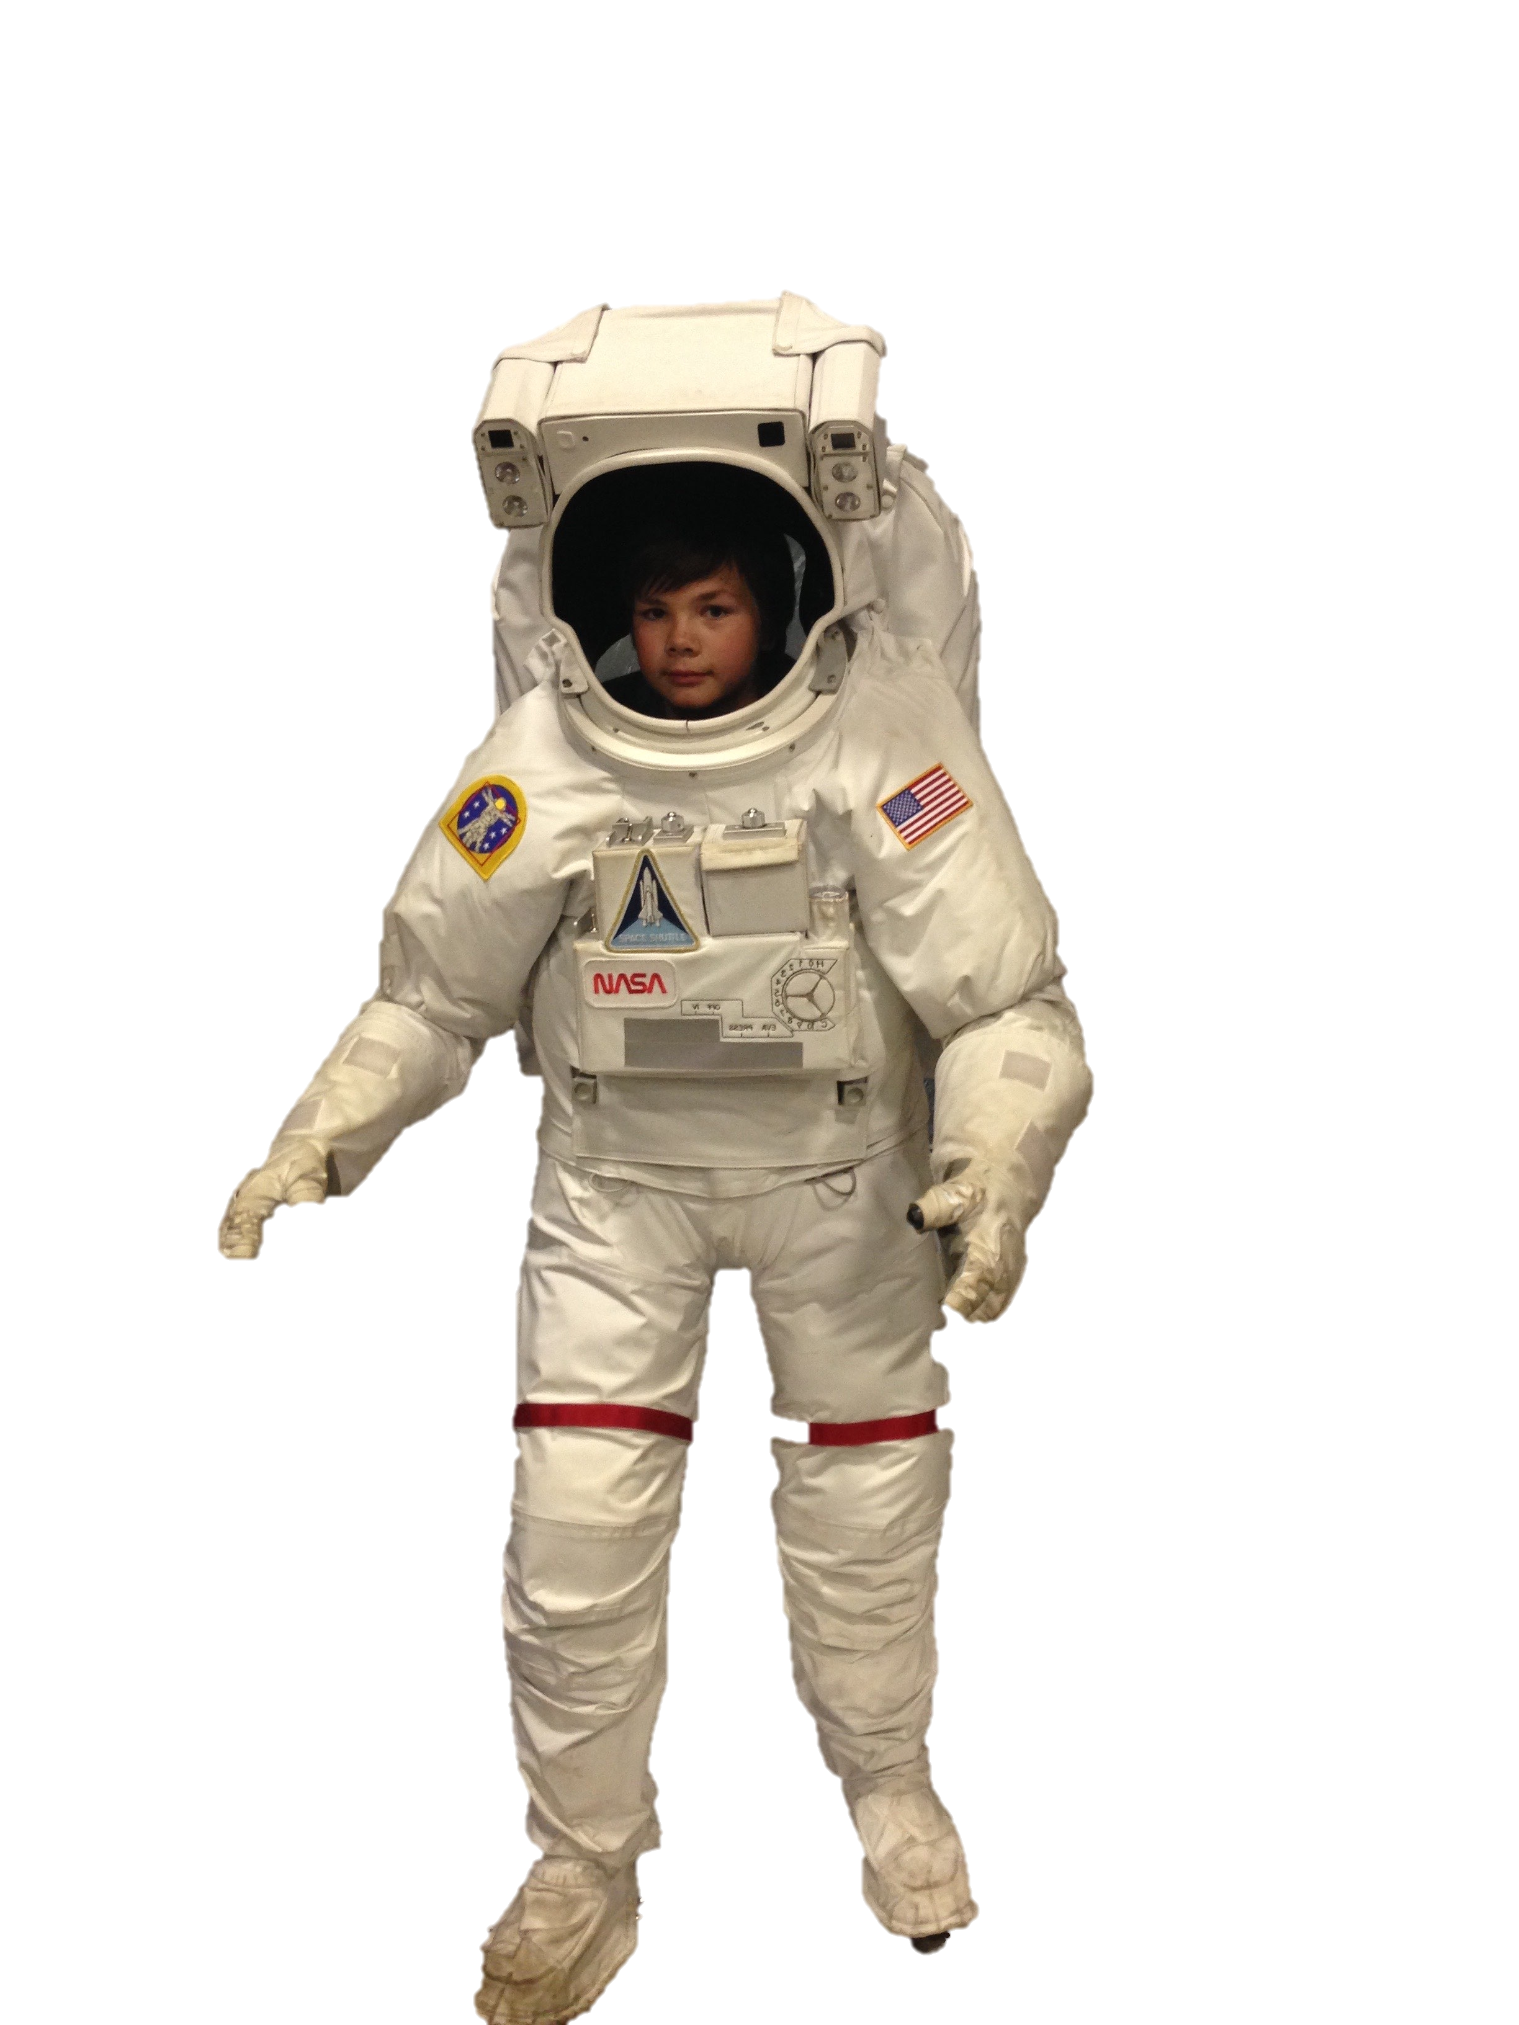
Methodology
Actual Project
Use Exo-Plex to calculate a planet’s density and structure
Calculate planet structures from mass-proportions
Place structure and composition in context of mineral and orbital parameters
Assumptions
Mg/H=Fe/H
Si/H=Fe/H
Fe/Mg=0.9
Si/Mg=0.9
Ca/Mg=0.07
Al/Mg=0.09
Planetary values
Mass=1.66 M_earth
Radius=1.15 R_earth
A = 0.0153 AU
L = 0.00436 L_sun
The planet we chose was GJ 1132b, using Exo-Plex we define our variables and use the defined code to get some results, then comparing them to Earth

Slide 6

Results
The Code finds a Bulk-density for GJ 1132b of roughly 6.25 g/cm^3 (Earths is 5.514g/cm^3)
The Model shows a near solar Fe/Mg ratio with most iron residing in the core
Orbital: GJ 1132b is highly irradiated assuming little to no atmosphere
Mineral: The planets mantle is different from Earths with a much richer supply of Mg and Si

Slide 7

Conclusion
Exo-Plex reveals GJ 1132b is a dense, rocky exoplanet with a substantial core, a concentration linked highly to its star, and an irradiated surface. Its composition various drastically from that of Earth.
This project demonstrated the effective use of Exo-Plex, and how much can be learned from exoplanets simply by studying their stars. This helps us as we leave this class onto future educational endeavors and our curiosity for the unknown grows larger

Slide 8

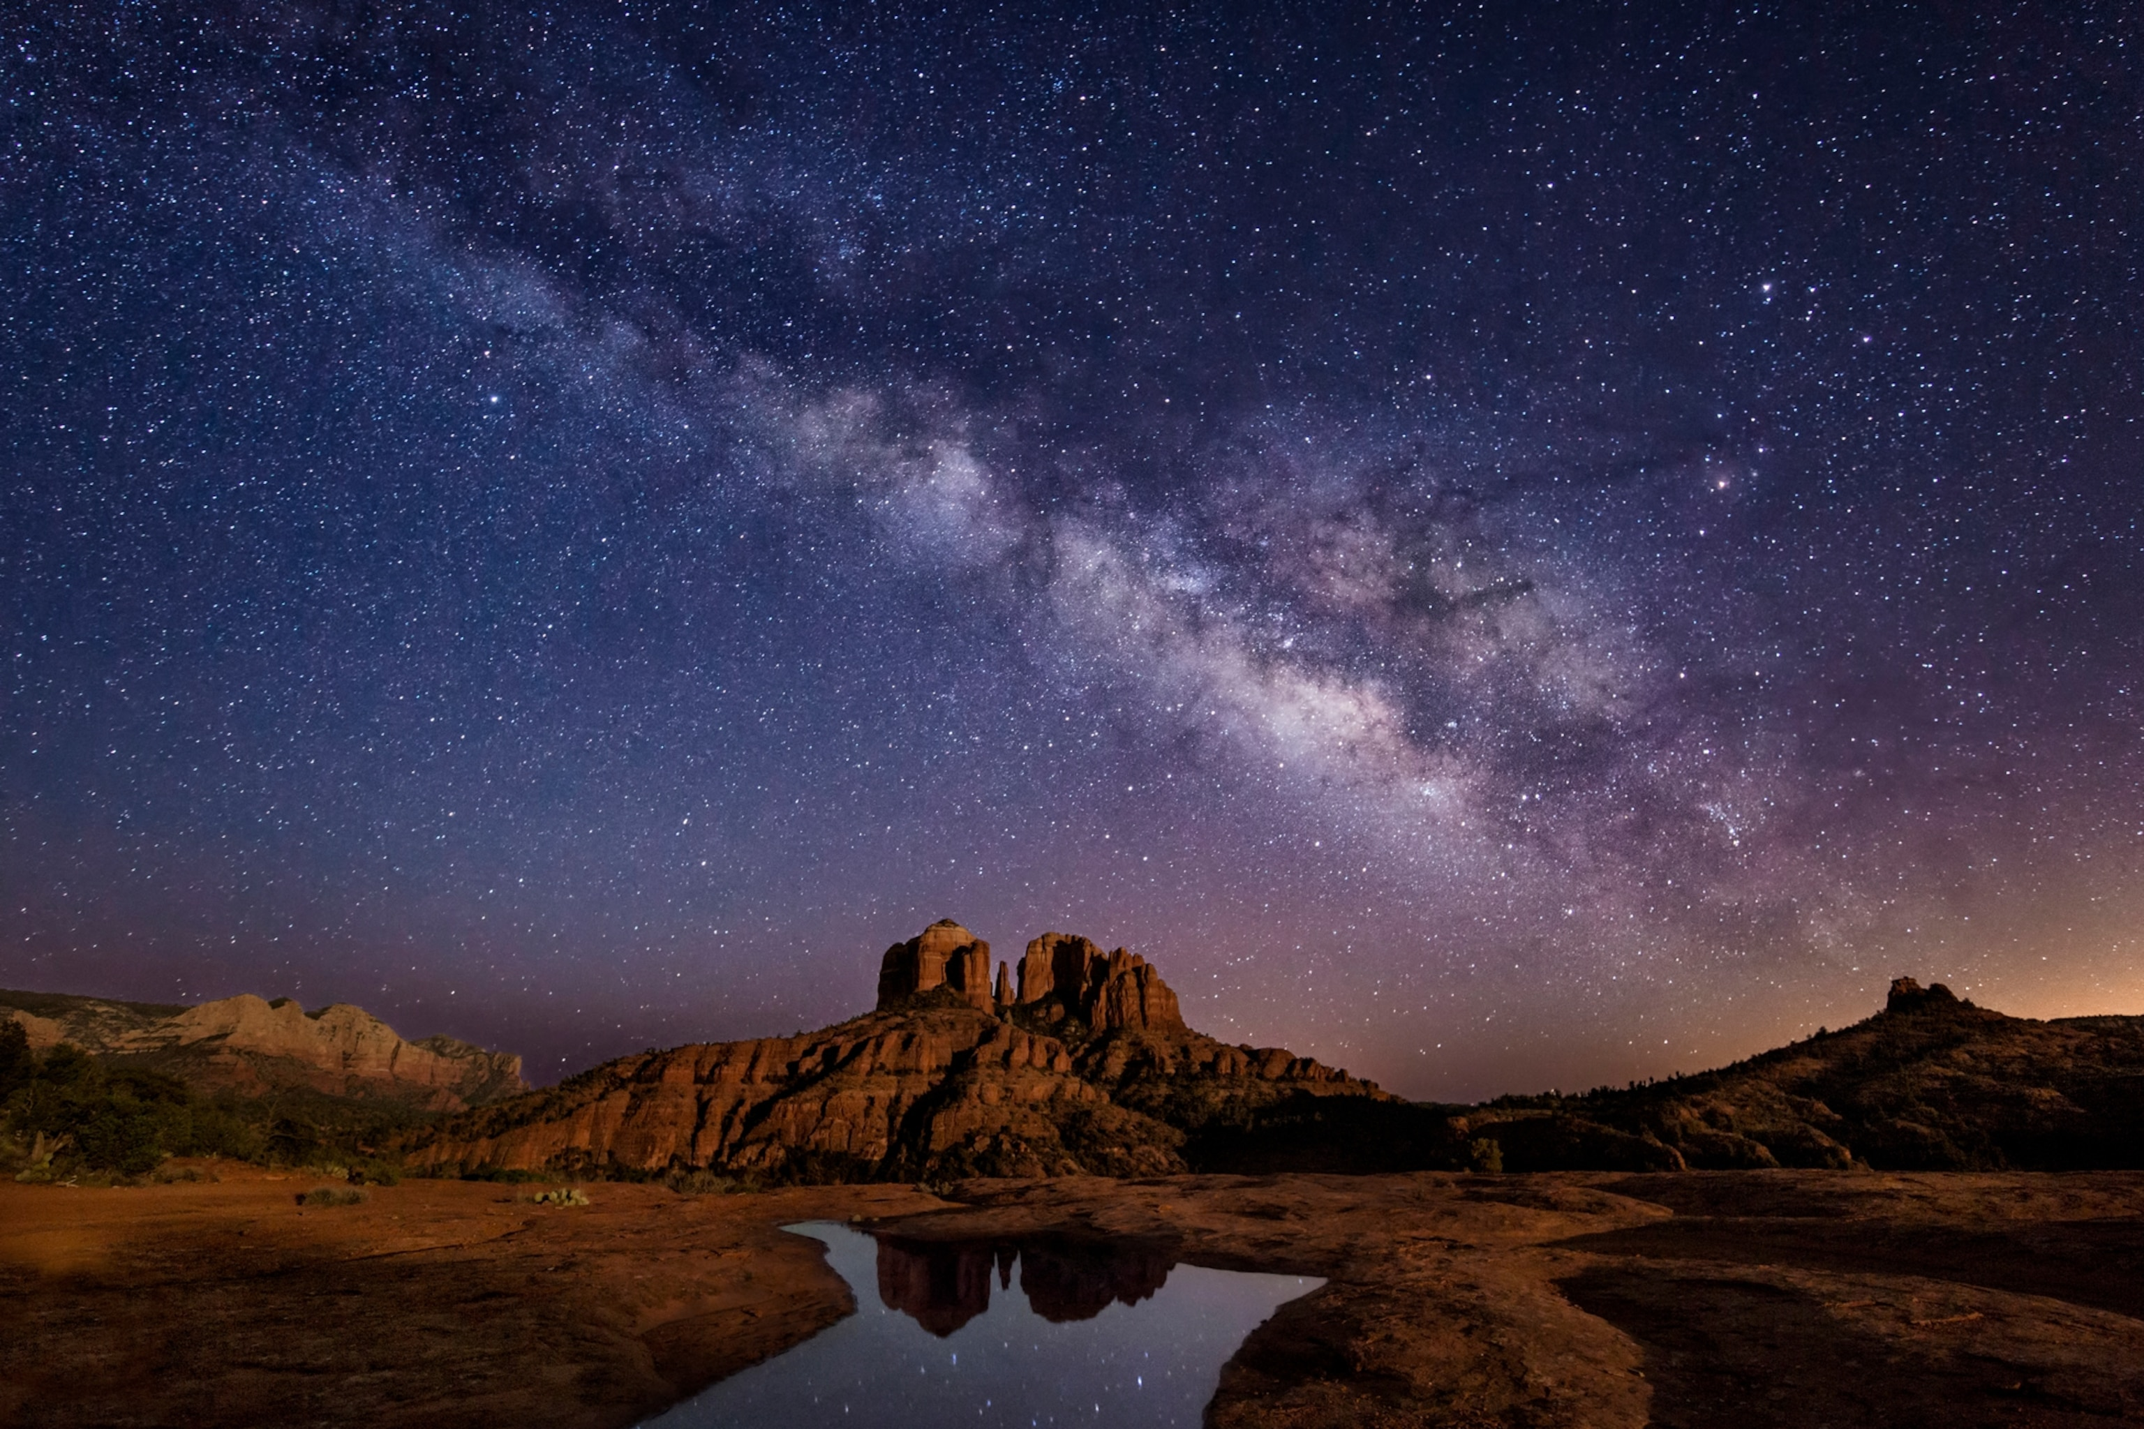
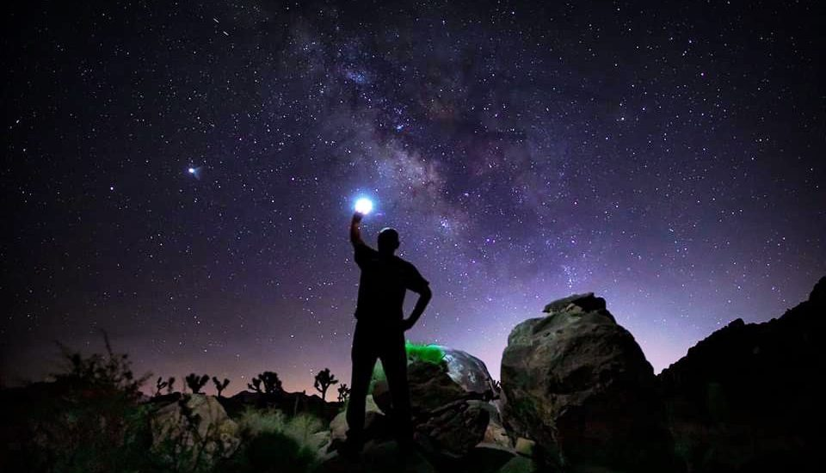
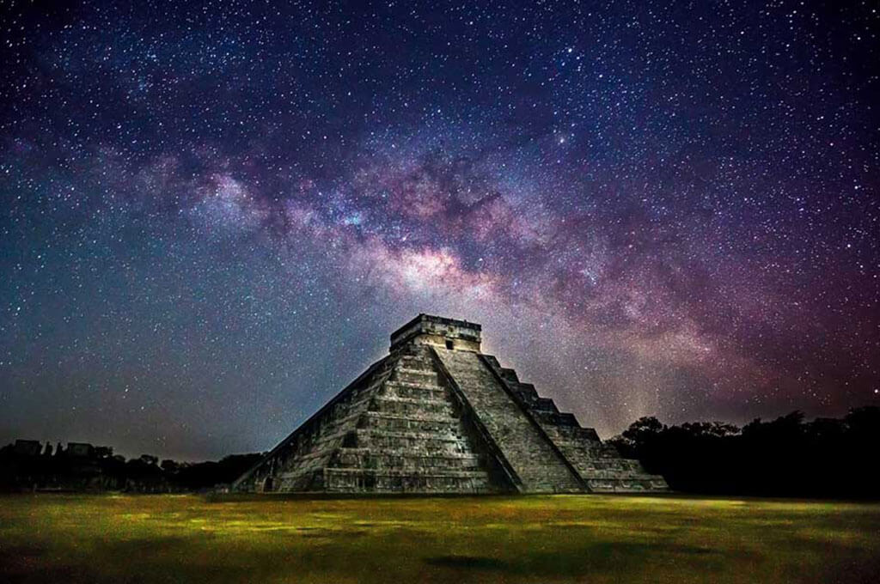
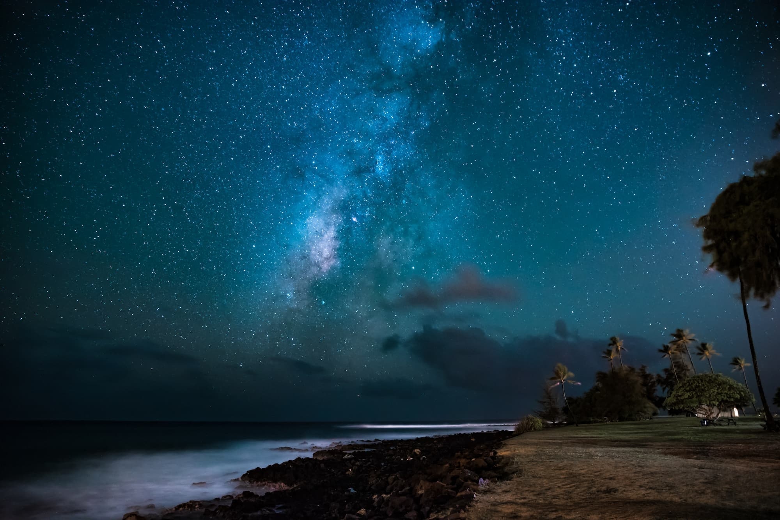
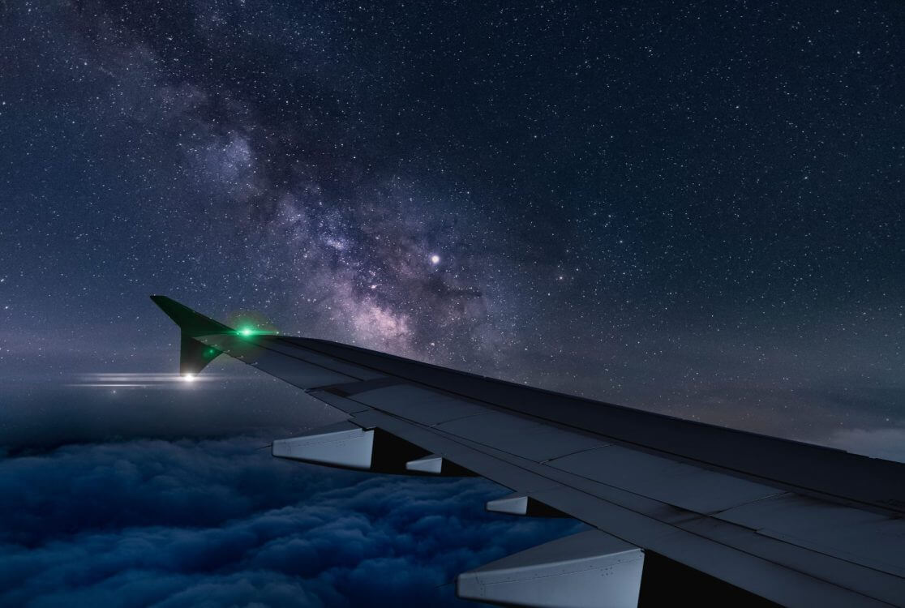
Fin
Thank you for a great semester!

